Slide 1
Neural Networks II receptive Fields

Slide 2
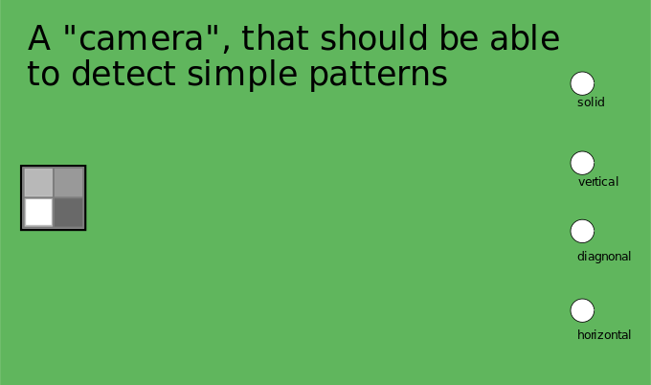
On the left is a camera with 4 input fields. On the right are the output fields. The system should be able to distinguish between whole, vertical, diagonal and horizontal patterns.

Slide 3
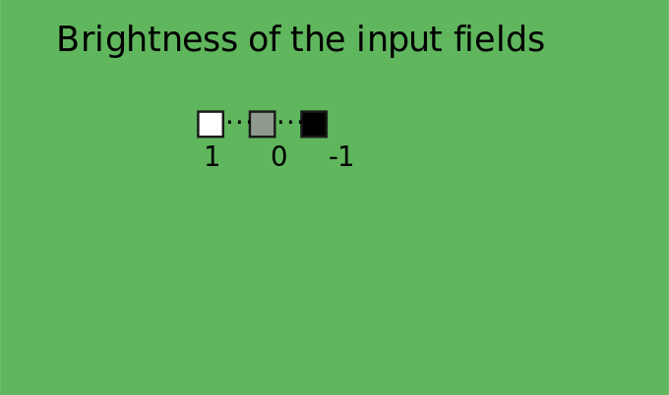
The input fields can have continuous values in the range [-1, 1].

Slide 4
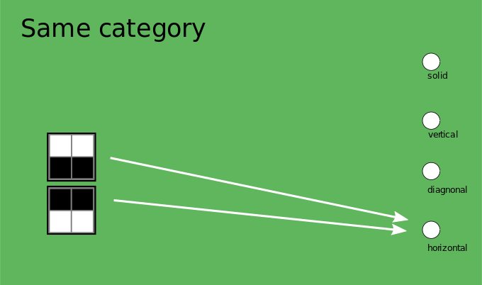
Example for the recognition of a horizontal pattern

Slide 5
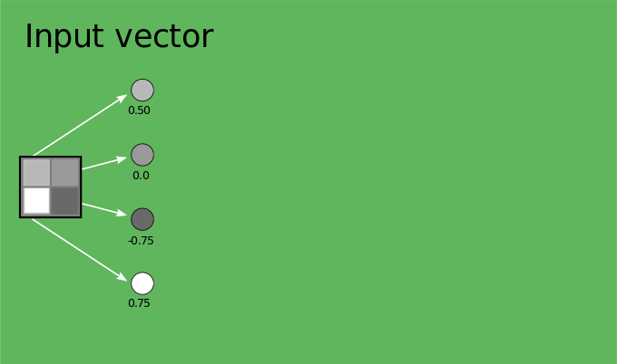

Slide 6
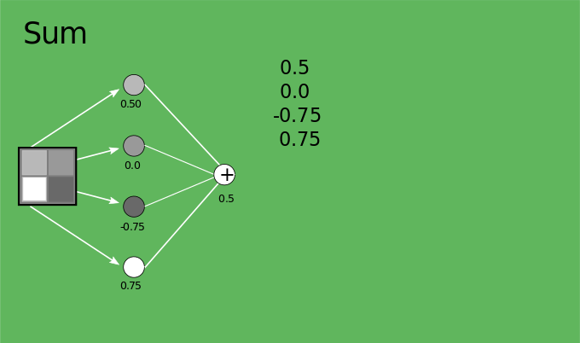

Slide 7
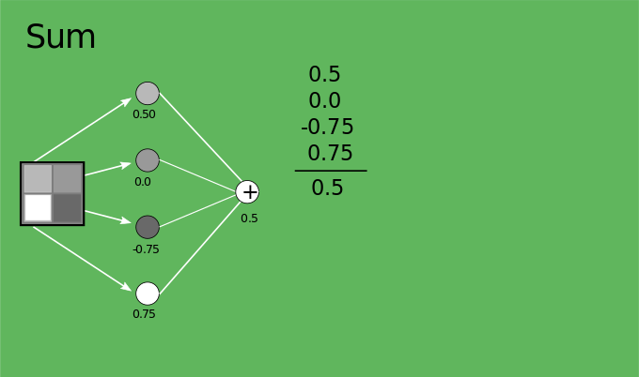
The neuron forms the sum of the input vector.

Slide 8
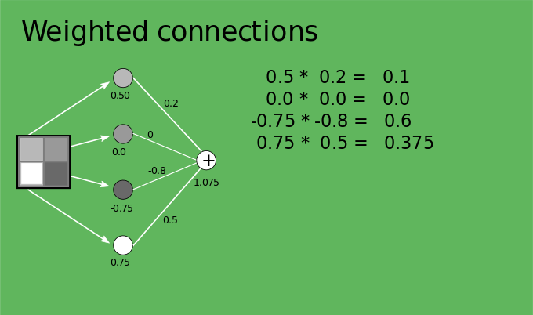
The connections have different weights.

Slide 9
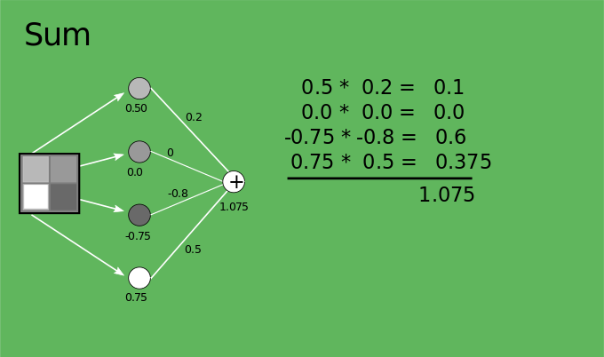

Slide 10
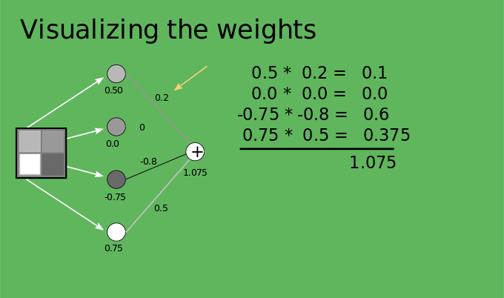

Slide 11
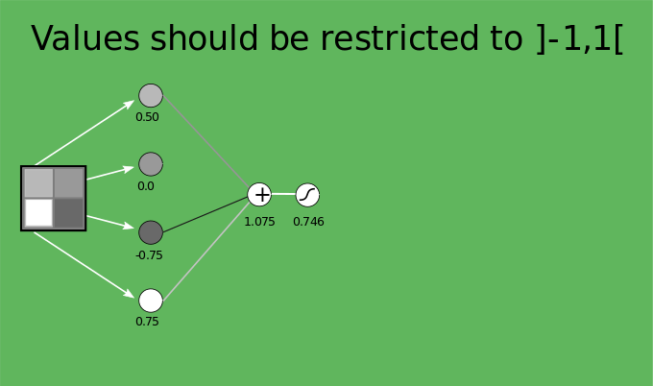
The result value should always remain in the interval ]1,1[. This is ensured by the additional element on the far right ( ). It is used as a restriction and at the same time as an activation function.

Slide 12
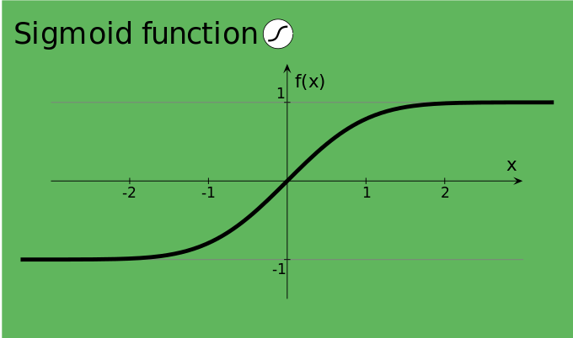
advanced content for the restriction function
For example, the sigmoid function can be used as a restriction function.

Slide 13
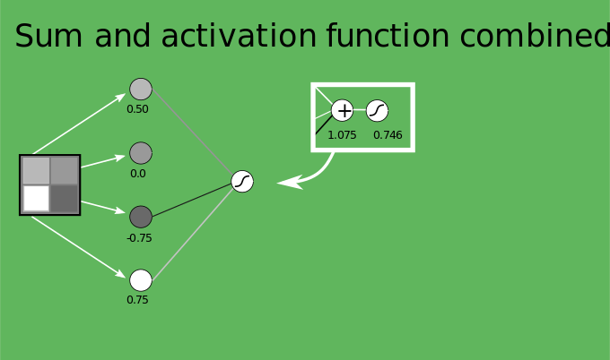
For the sake of simplicity, we combine both.

Slide 14
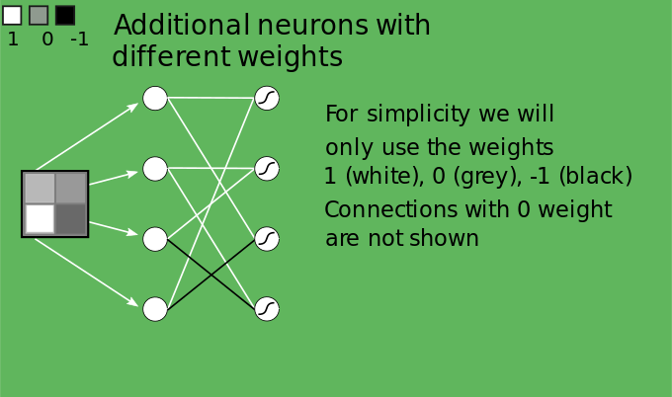
We add more elements in this layer.

Slide 15
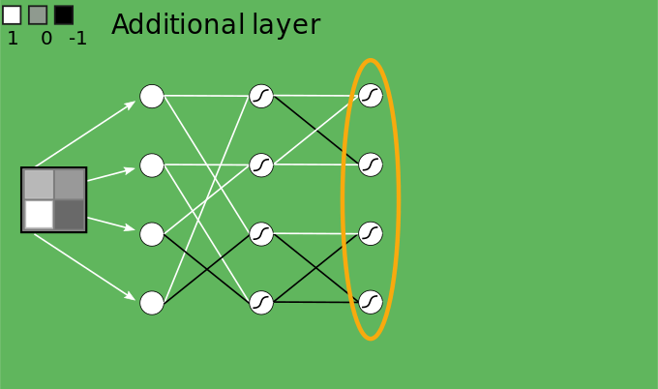
We now add another layer.

Slide 16
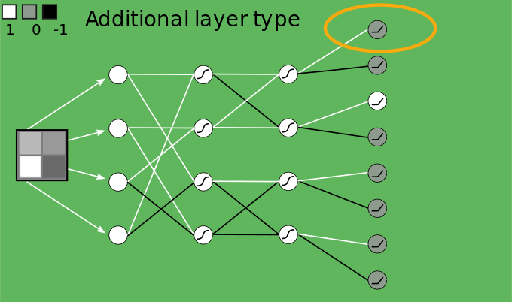
Finally, another layer with another type of neural cell.
In contrast to the previous activation function, this Function does not pass through negative values and sets them to 0.

Slide 17
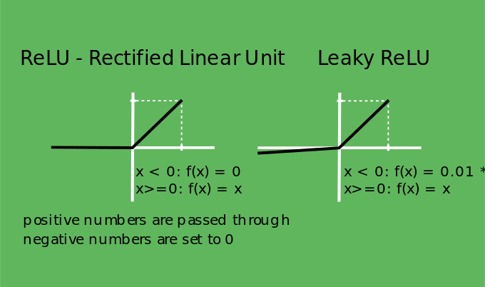
Advanced content for the activation function
The ReLU function can be used here, or alternatively Leaky ReLU. Leaky ReLU has some advantages when training the network.

Slide 18
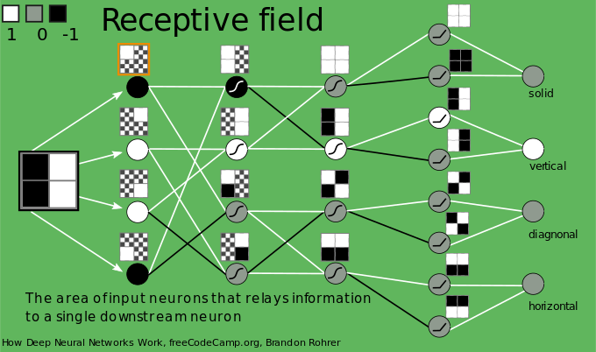
Complete network showing the receptive field for each neuron

Slide 19
You can try all of this in the simulator.
The simulator is available in the automatic as well as in the manual version.
simulator

Slide 20
Source
How Deep Neural Networks Work - Full Course for Beginners https://www.youtube.com/watch? v=dPWYUELwIdM&t=1264s&ab_channel=freeCodeCamp.org

